Slide 1



Pedestrian Emergency Braking in Ten Weeks
Steven Nguyen
University of California, Santa Barbara
Dept. of Mechanical Engineering
Zillur Rahman and Brendan Tran Morris
University of Nevada, Las Vegas
Dept. of Electrical and Computer Engineering

Slide 2
Outline
Motivation and Background
Methods
Longitudinal/Lateral Control
Pedestrian Detection
Experimental Evaluation
Simulation Environment
Vehicle Platform Setup
Pedestrian Detection
In-vehicle Test
Concluding Remarks

Slide 3
Overview
10 week research program as part of UNLV’s NSF REU: Smart Cities site
Develop a control algorithm for pedestrian emergency braking system in autonomous vehicles
Implement the controller in a real vehicle and test its safety
Demonstrate ability for safe braking
Establish UNLV’s first autonomous vehicle platform
Funding from NSF, award no. 1950872

Slide 4
Background
Existing control approaches include PID, MPC, fuzzy logic, neural networks, etc.
PID used in this work for rapid implementation and computational speed
Sufficient for basic maneuvers
Past works in implementation for autonomous vehicles commonly use ROS
Alternatively, some researchers have used User Datagram Protocol (UDP)
ROS more widely used and was selected for ease of implementation
Goal was to use widely available resources for this project
ROS, Linux, Logitech webcam

Slide 5
Outline
Motivation and Background
Methods
Longitudinal/Lateral Control
Pedestrian Detection
Experimental Evaluation
Simulation Environment
Vehicle Platform Setup
Pedestrian Detection
In-vehicle Test
Concluding Remarks

Slide 6
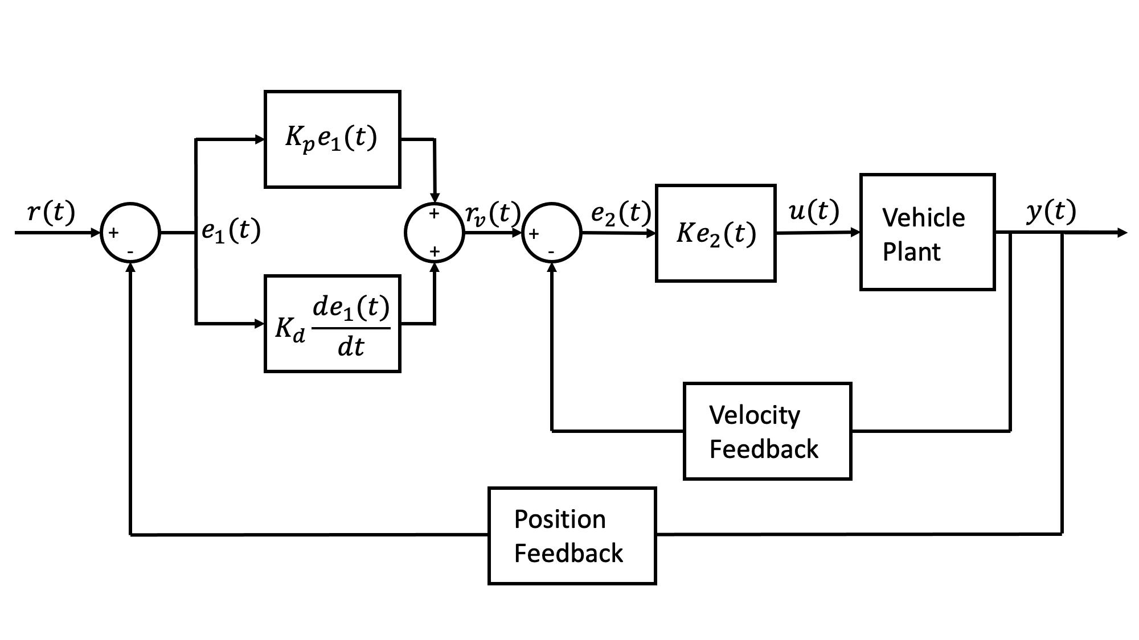
Longitudinal Control Design
Applied PID approach
Important considerations were safety and comfort
Velocity and position feedback used to prevent overshoot, increase safety
Reference position provided is distance from pedestrian minus headway
Vehicle plant used brake data from Dataspeed
Notes:
(Factors considered in control design)
(Block diagram and modeling)
(Simulation results)
(Show both longitudinal and lateral controllers but focus a bit more on the long.)

Slide 7
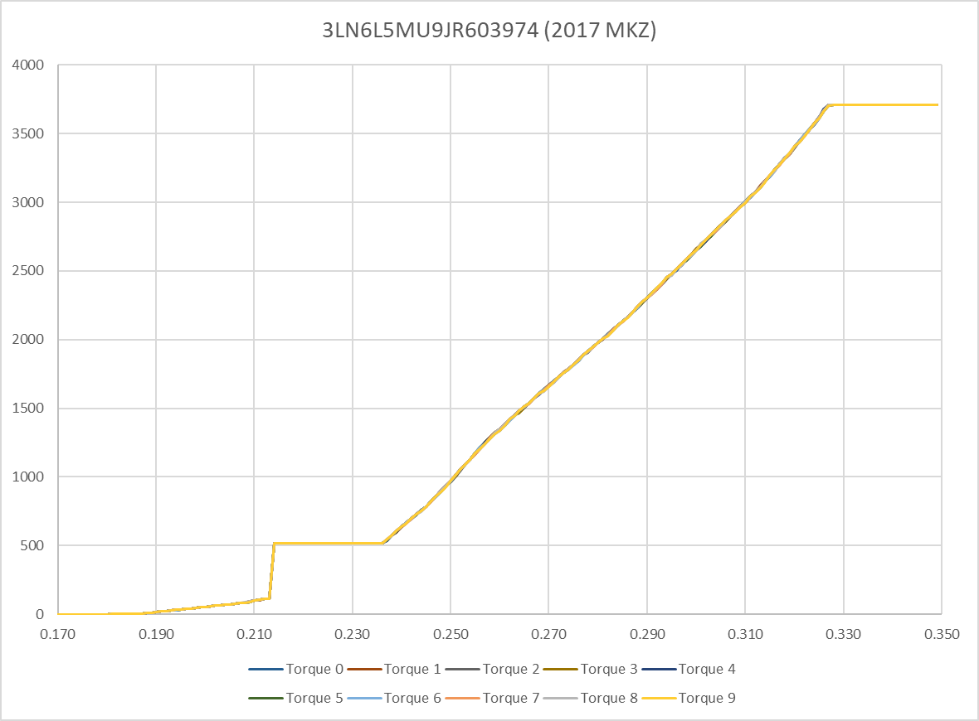
Longitudinal Control Design - cont.
Vehicle datasheet only showed data up to brake values ~0.35
Due to this and for comfort, brake values limited to 0.4 in controller

Slide 8
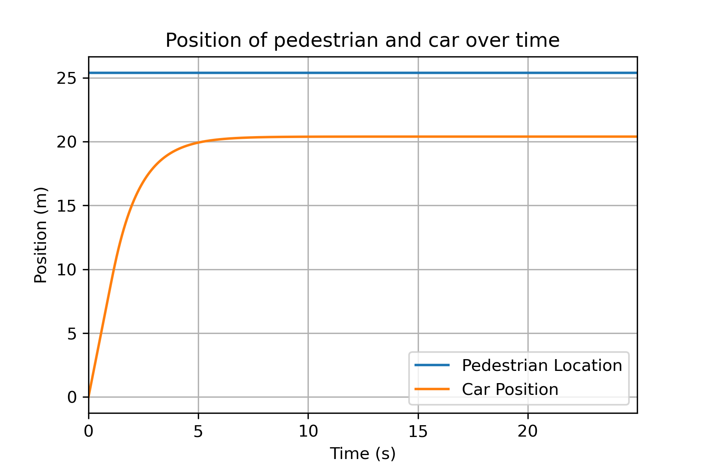
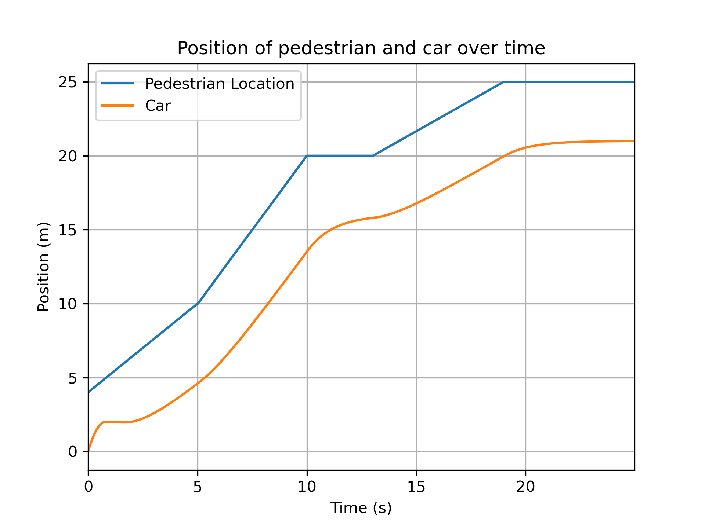
Longitudinal Control Design - cont.
Simulations verified controller safety
Tested step inputs and arbitrary pedestrian reference
Implemented in vehicle after verification

Slide 9

Lateral Control Design
Similar approach to longitudinal controller
Purpose is to steer for lane tracking or vehicle following
Reference position is the center of lane to follow or a lead vehicle
Instead of velocity feedback, used yaw rate feedback

Slide 10
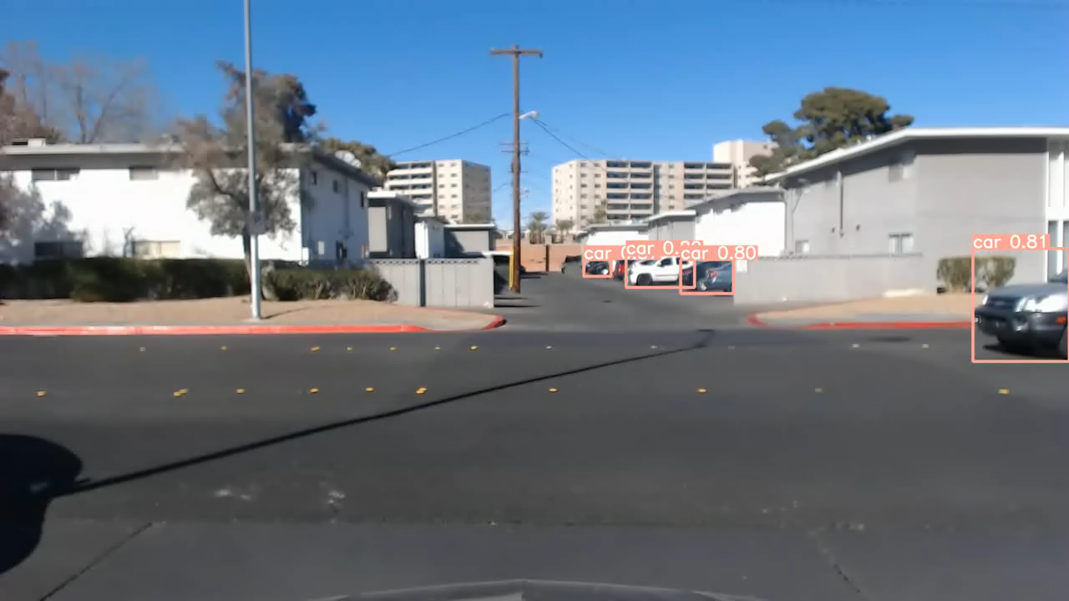
Pedestrian Detection Algorithm: 2D Detection
YOLOv5 was used to detect 2D objects from video frames.
Trained on MS COCO dataset and customized to infer only on relevant classes
Provides 2D bounding box coordinates for each object. No depth information.

Slide 11
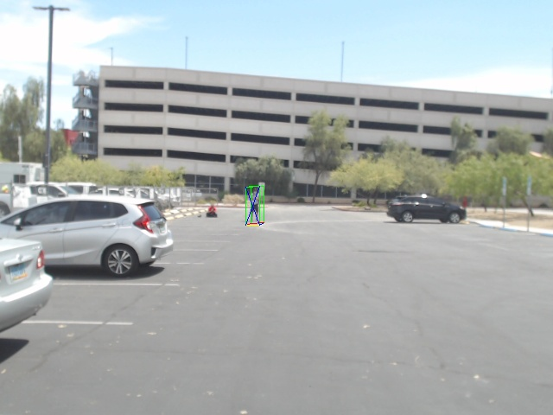
Pedestrian Detection Algorithm: 3D Detection
VGG-16 network trained on KITTI dataset estimates the 3D object properties
Geometric constraints provided by YOLOv5 were combined with those estimations to get depth information
Ped. distance used in controller feedback
Implemented using webcam on vehicle
Sample detection from camera

Slide 12
Outline
Motivation and Background
Methods
Longitudinal/Lateral Control
Pedestrian Detection
Experimental Evaluation
Simulation Environment
Vehicle Platform Setup
Pedestrian Detection
In-vehicle Test
Concluding Remarks

Slide 13
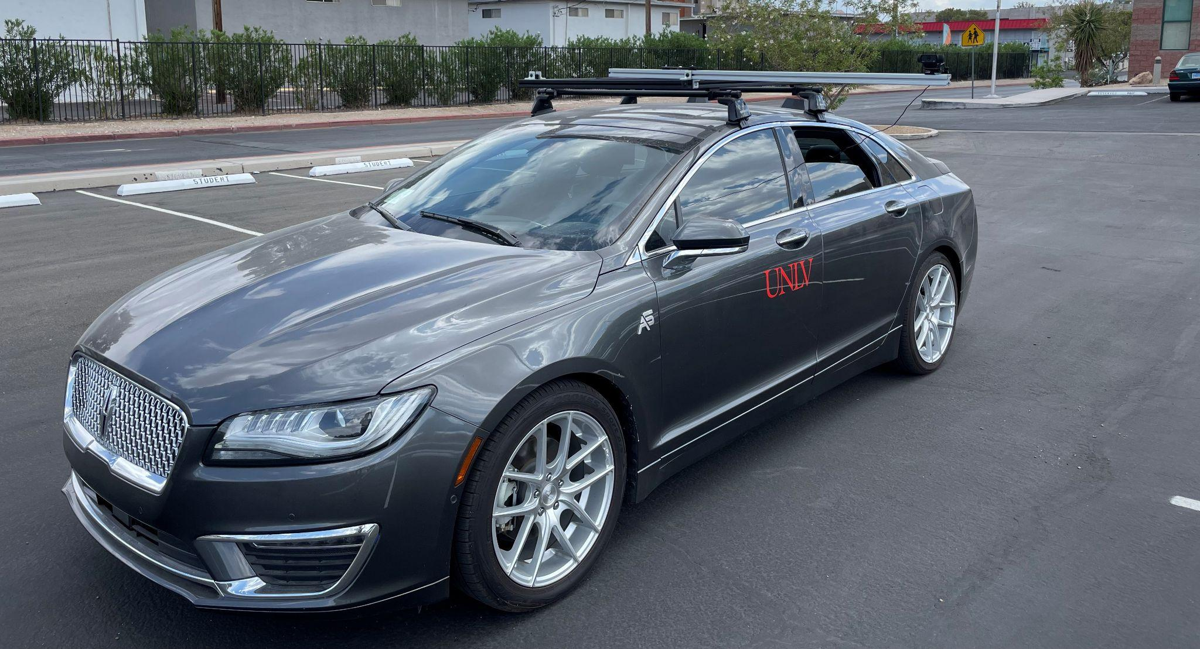
Vehicle Platform
2017 Lincoln MKZ Hybrid with Dataspeed drive-by-wire system
Logitech C920 camera
Offset position for safety
Computer specifications
Intel Xeon E5-2603
Nvidia RTX 2070 GPU
Ubuntu 20.04
ROS1 to read and write CAN messages
Sensor data from CAN
Communication between hardware and code

Slide 14
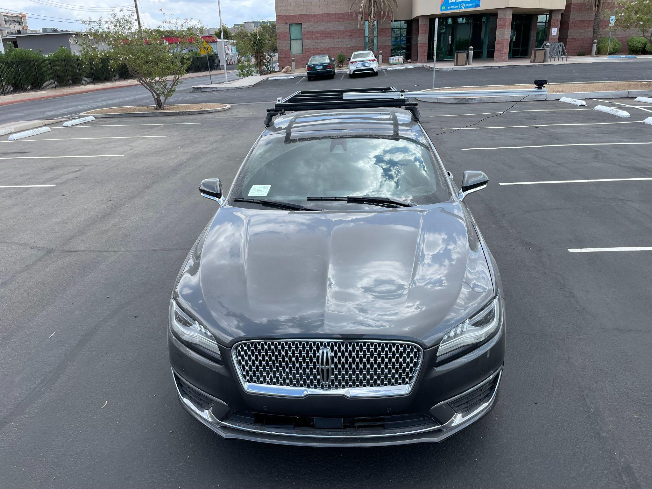
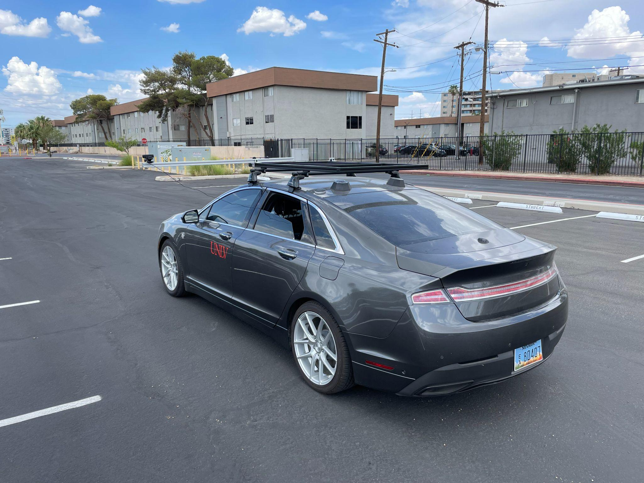
Vehicle Platform - cont.

Slide 15
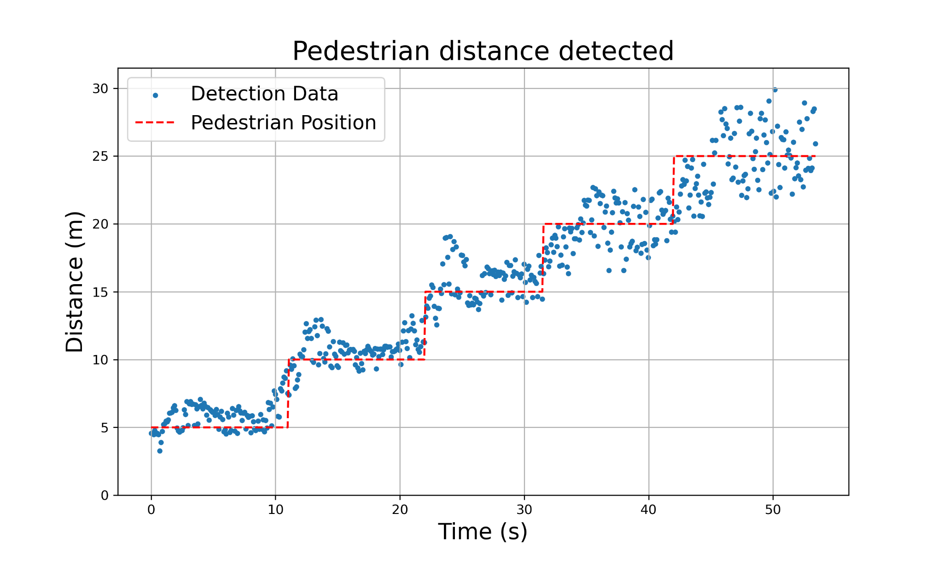
Pedestrian Detection Accuracy
Stationary pedestrian moving 5 meters every ~10 seconds
Vision-based detection is noisy
Detection is less precise at farther distances

Slide 16
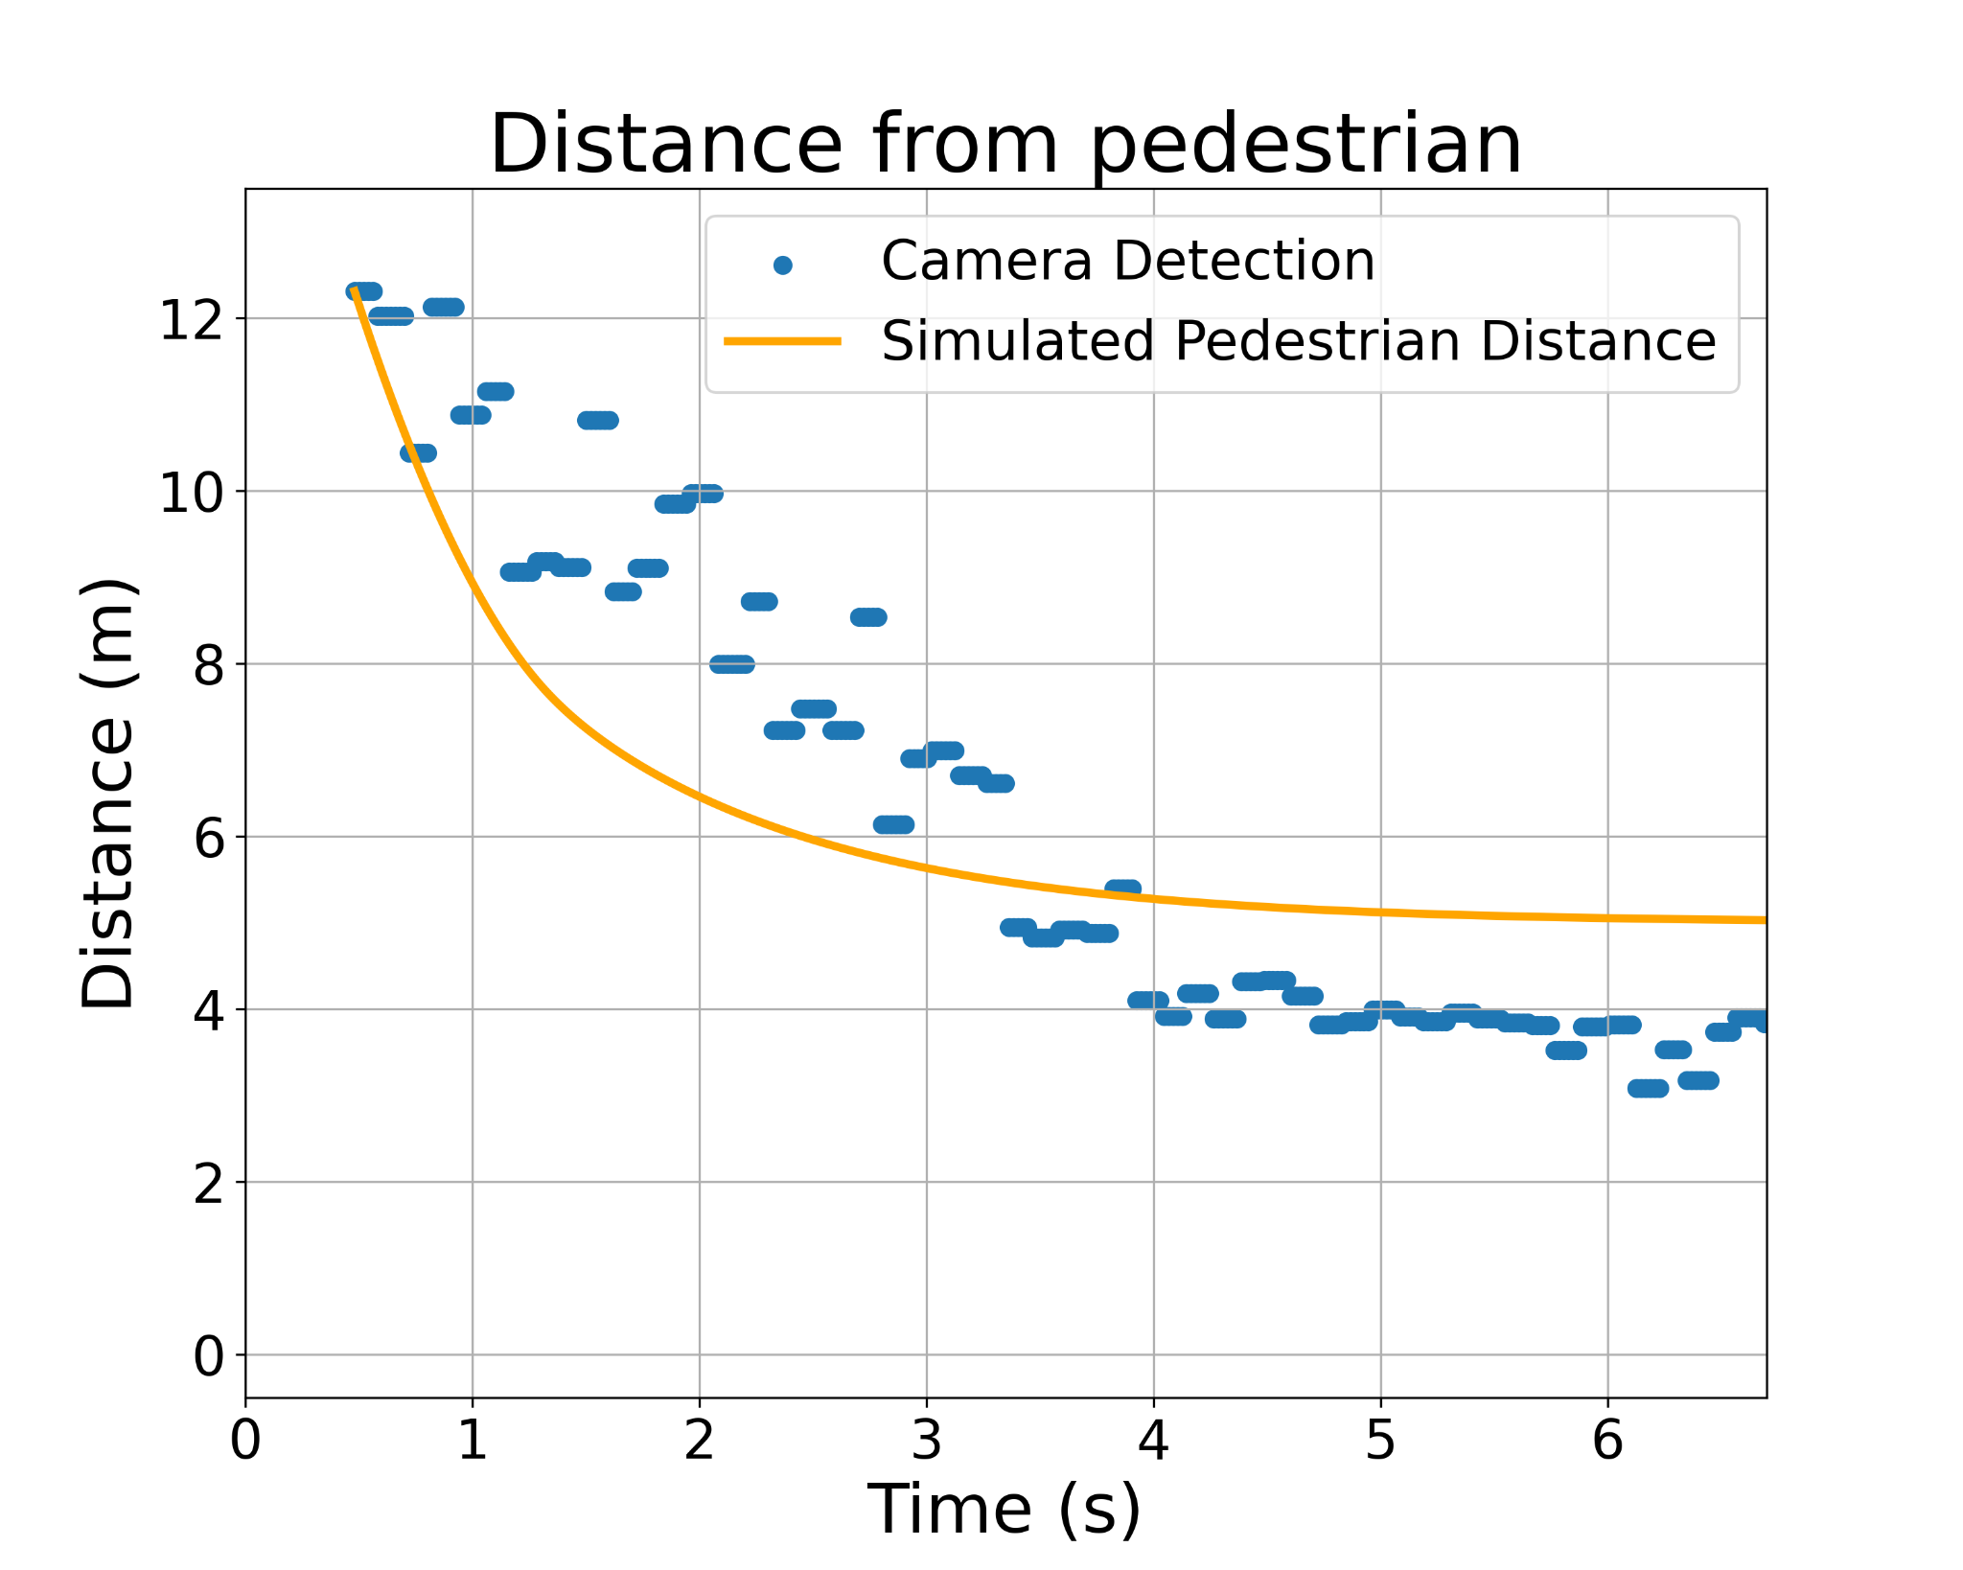
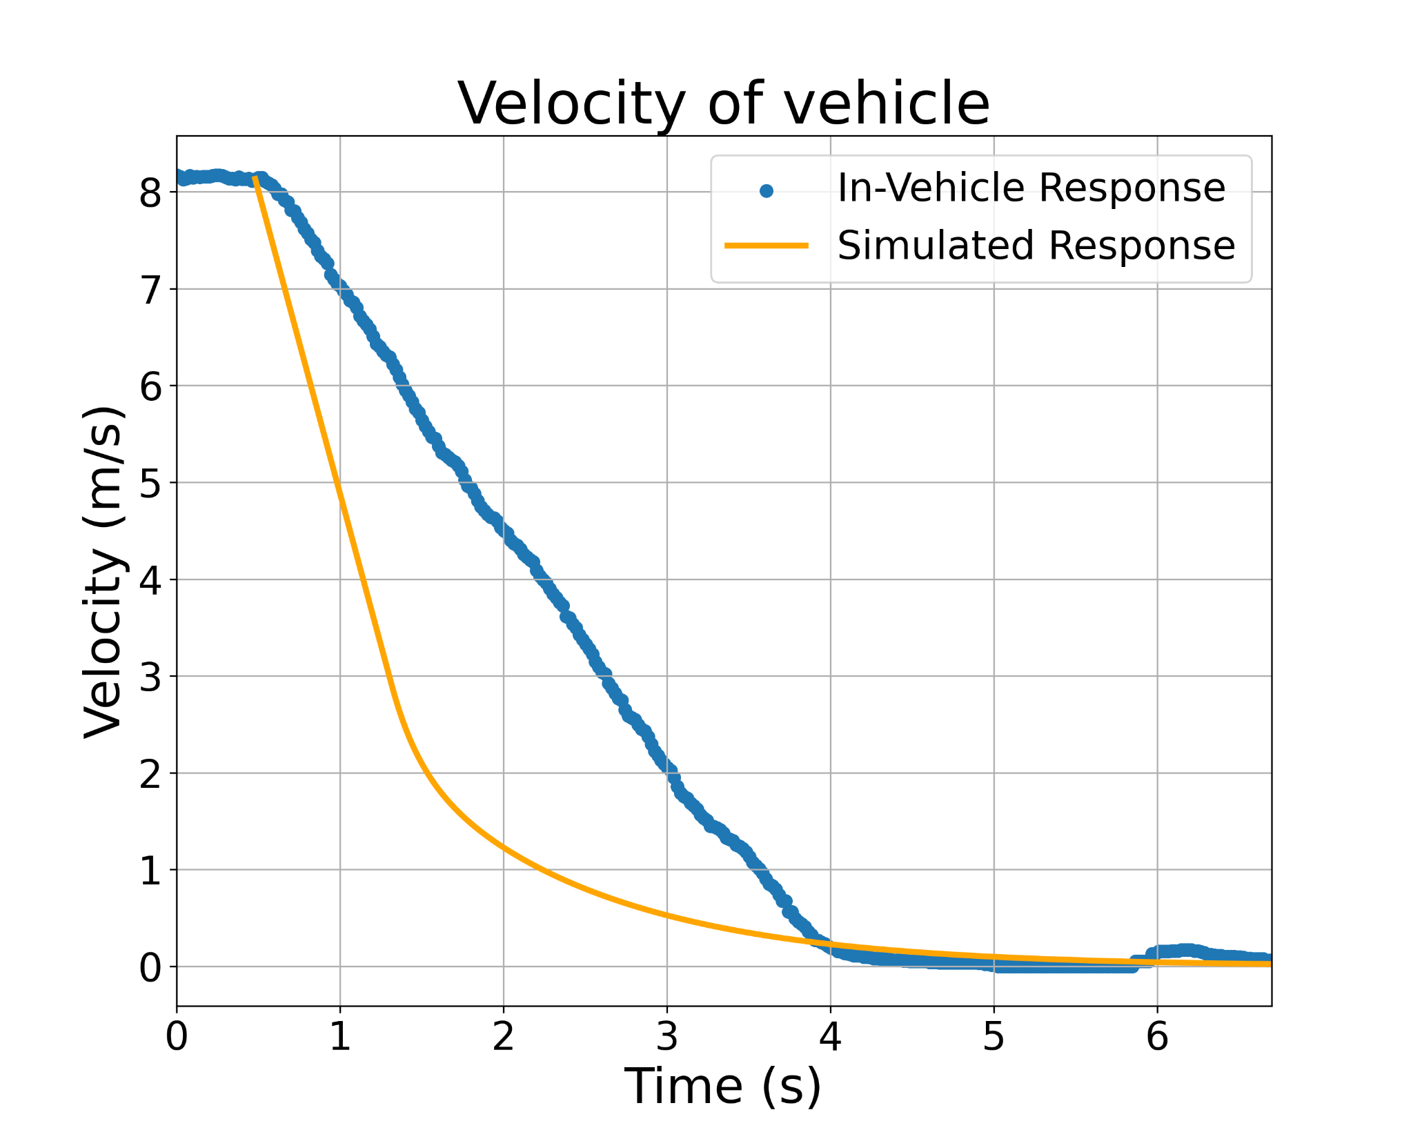
Brake Testing with Pedestrian
Longitudinal controller safely brakes at variable distance from pedestrian
Vehicle response not as fast as simulation
Discrepancy in test and sim motivates investigation of brake response model
Notes:
(Test results from testing with actual pedestrian)
(Do we need an extra slide to explain the setup with the bar sticking out with the camera?)
(Discuss results of testing)
(Should we also include lidar test data?)

Slide 17
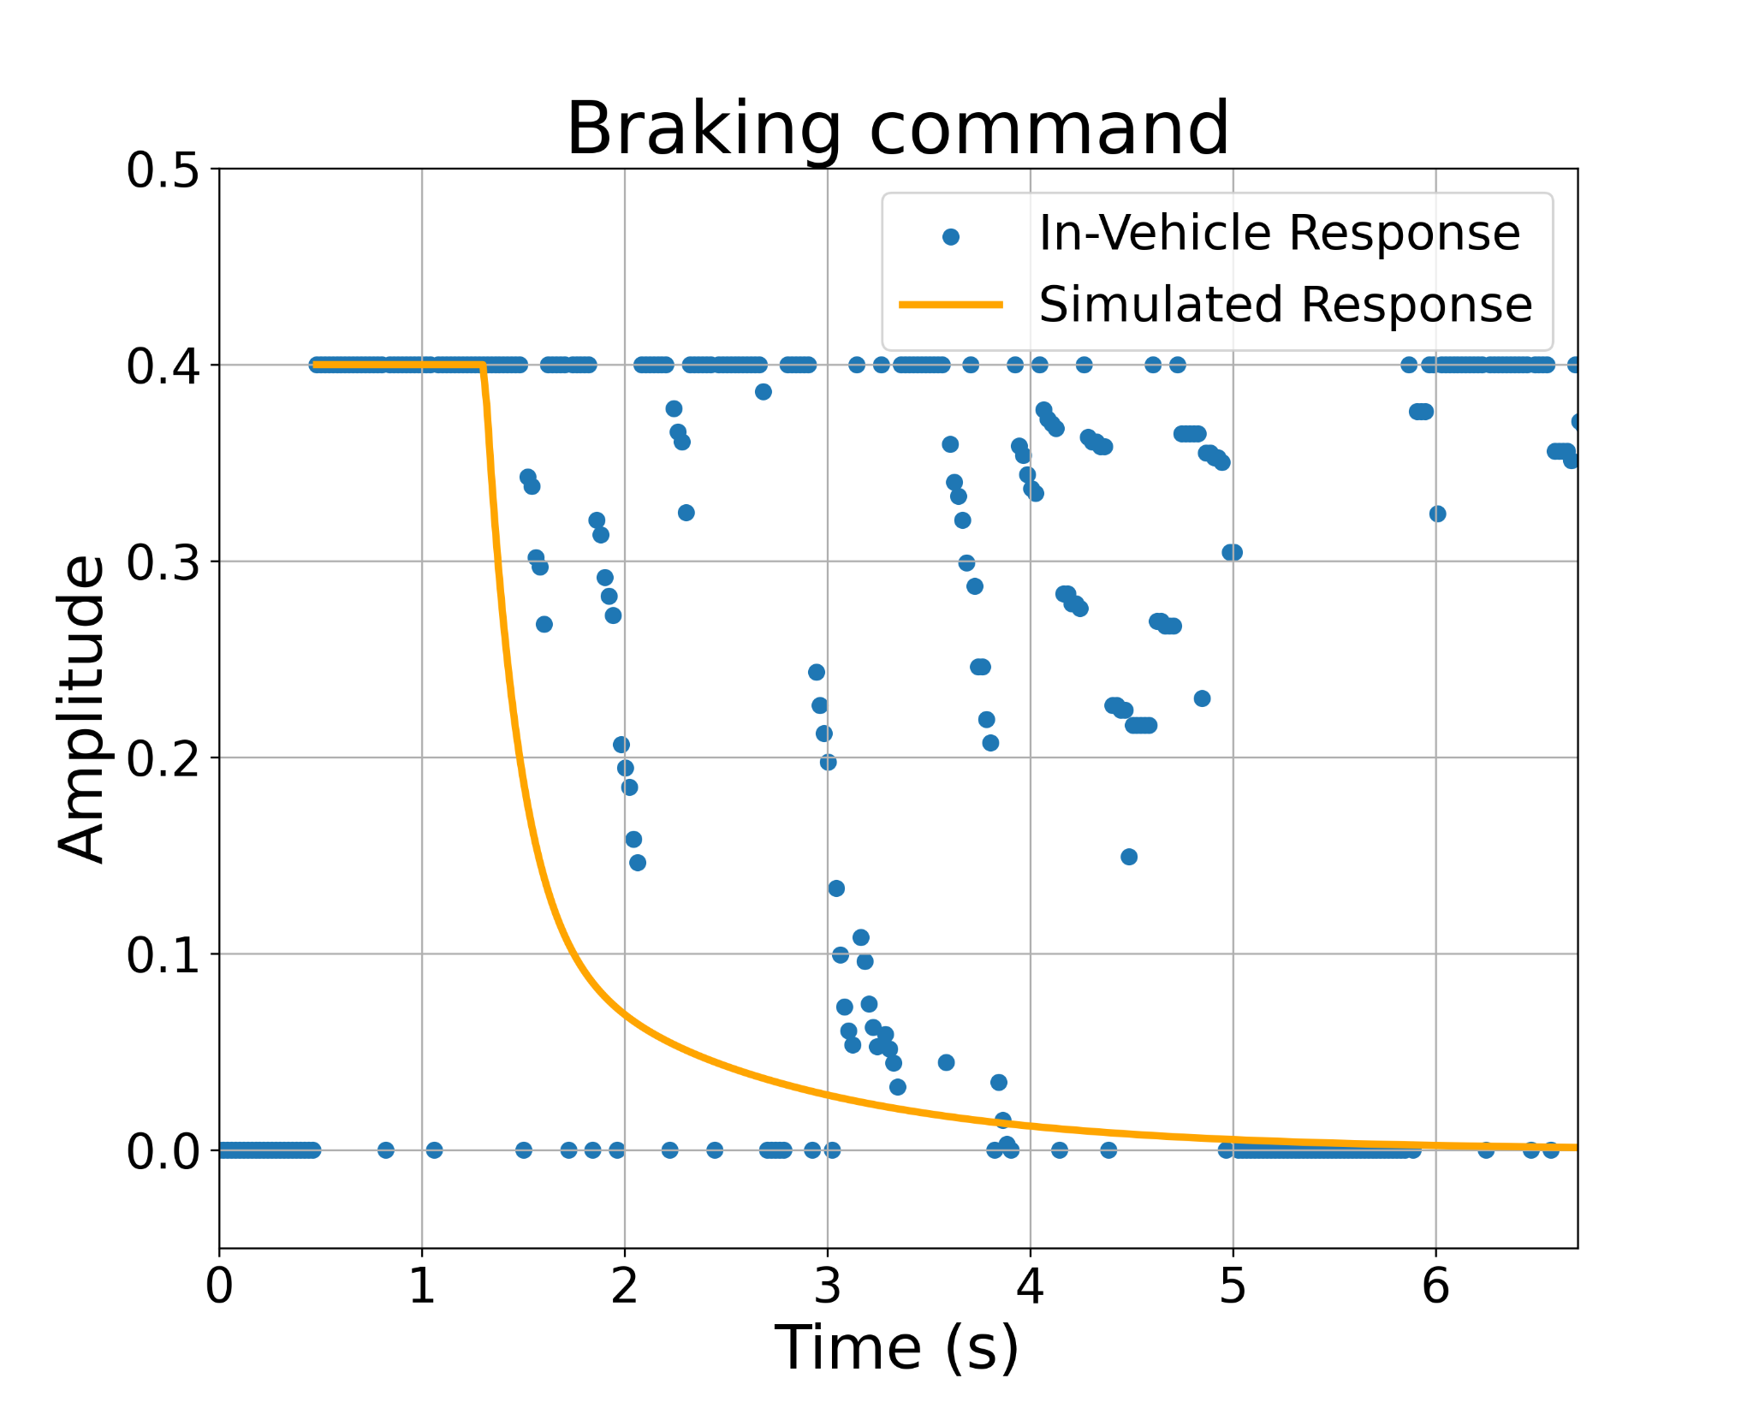
Brake Testing with Pedestrian
Controller saturates in live testing
Noise in pedestrian signal likely causes jumps in control signal
Control response is sometimes abrupt for passengers
Tuning control gains can create more gradual braking
Notes:
(Test results from testing with actual pedestrian)
(Do we need an extra slide to explain the setup with the bar sticking out with the camera?)
(Discuss results of testing)
(Should we also include lidar test data?)

Slide 18
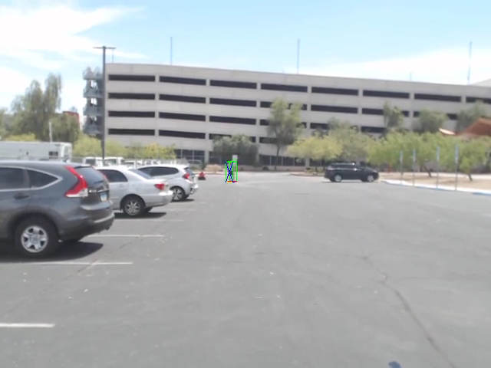
In-Vehicle Testing

Slide 19
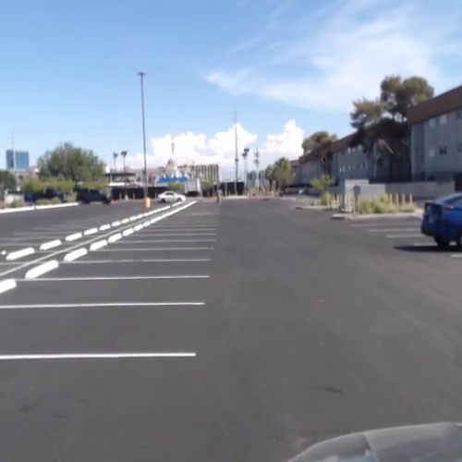
In-Vehicle Testing - cont.
Notes:
12-15 m

Slide 20
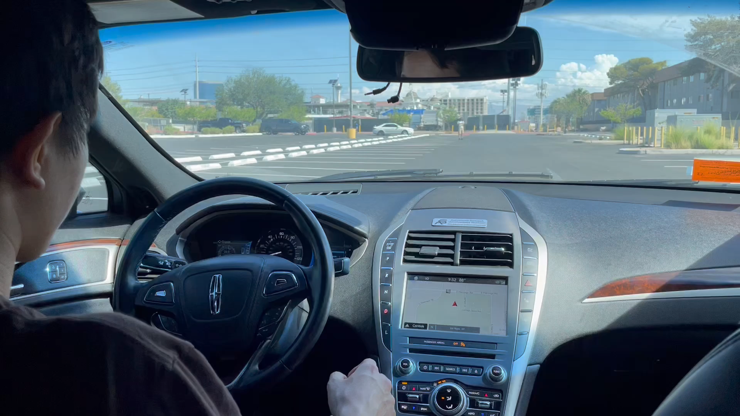
In-Vehicle Testing - cont.

Slide 21
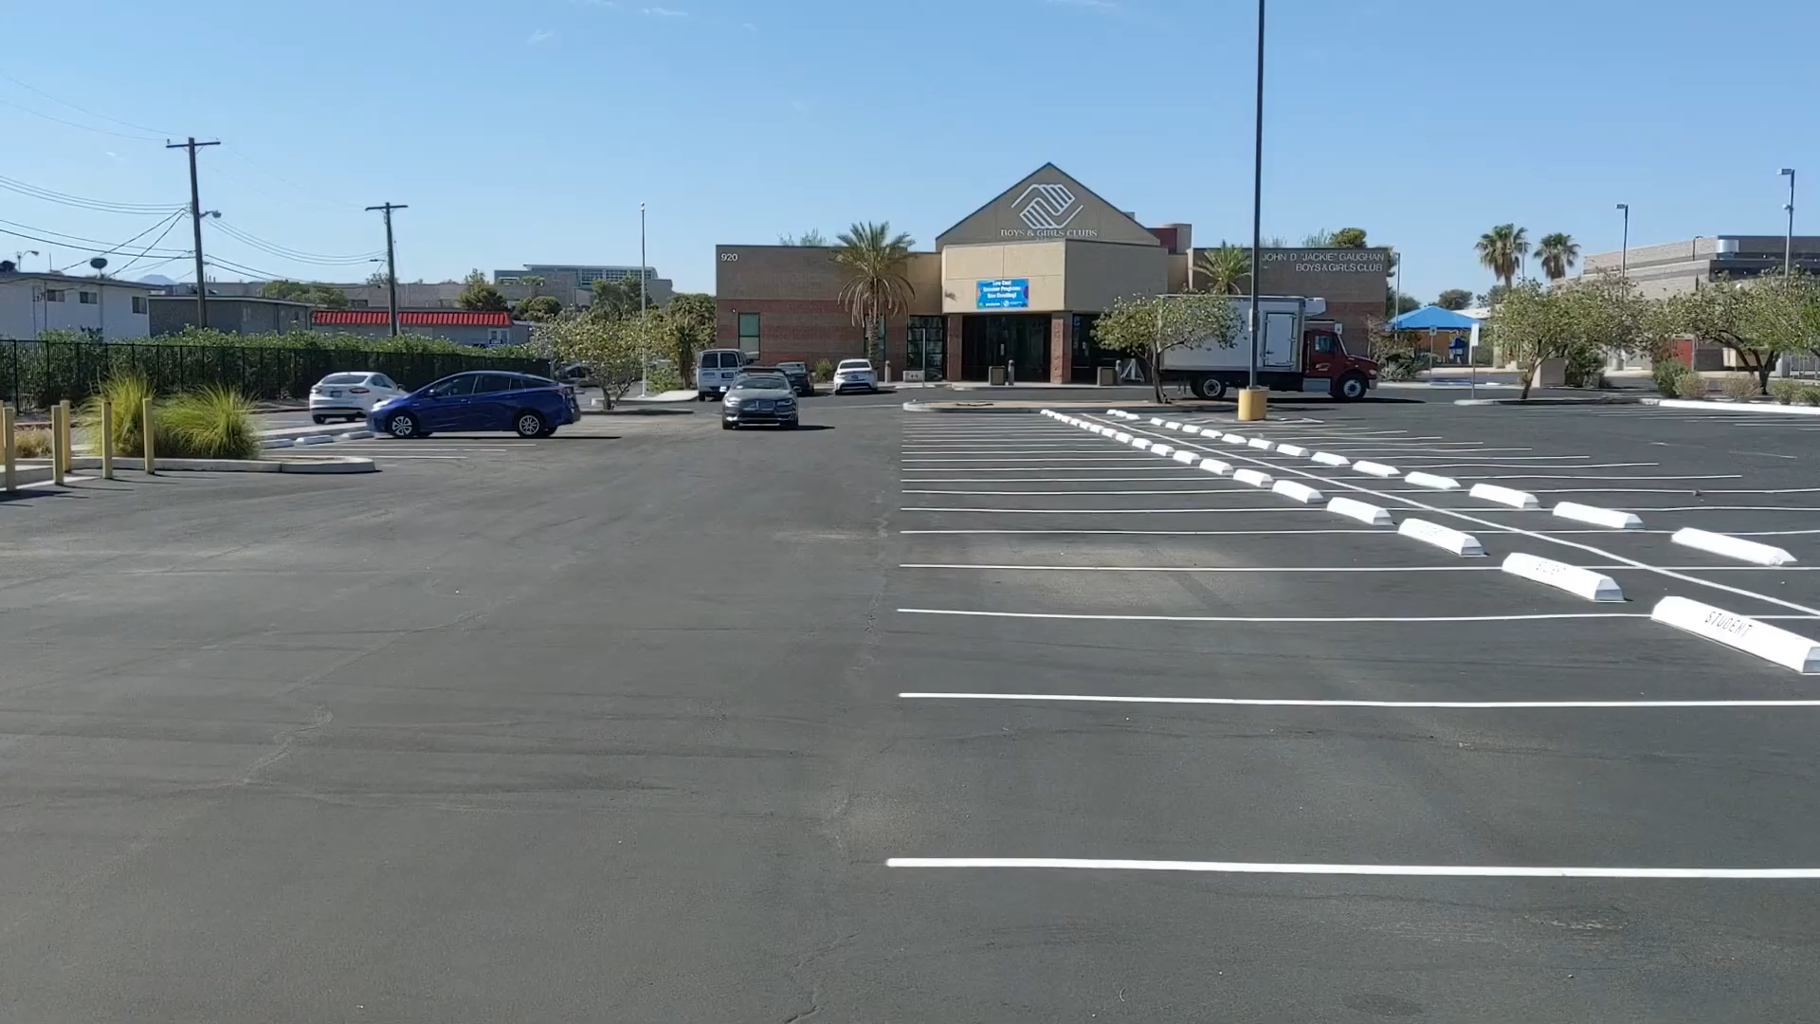
In-Vehicle Testing - cont.

Slide 22
Outline
Motivation and Background
Methods
Longitudinal/Lateral Control
Pedestrian Detection
Experimental Evaluation
Simulation Environment
Vehicle Platform Setup
Pedestrian Detection
In-vehicle Test
Concluding Remarks

Slide 23
Discussion of Results
The designed controller was successful and safe in braking tests
Began from scratch and achieved autonomous testing within ten weeks
Demonstrated rapid implementation and basic testing of autonomous vehicle functionality
Vehicle platform enables further research at UNLV for autonomous vehicles

Slide 24
Future Work
Use sensors that can generate smooth pedestrian signal (lidar) through sensor fusion
Implement filters to track pedestrian position more smoothly
Further investigate reliability of controller at varying speeds and smoothness of braking with smoother pedestrian signal
Incorporate lateral control for testing

Slide 25
Thank you.
Questions?

